Slide 1
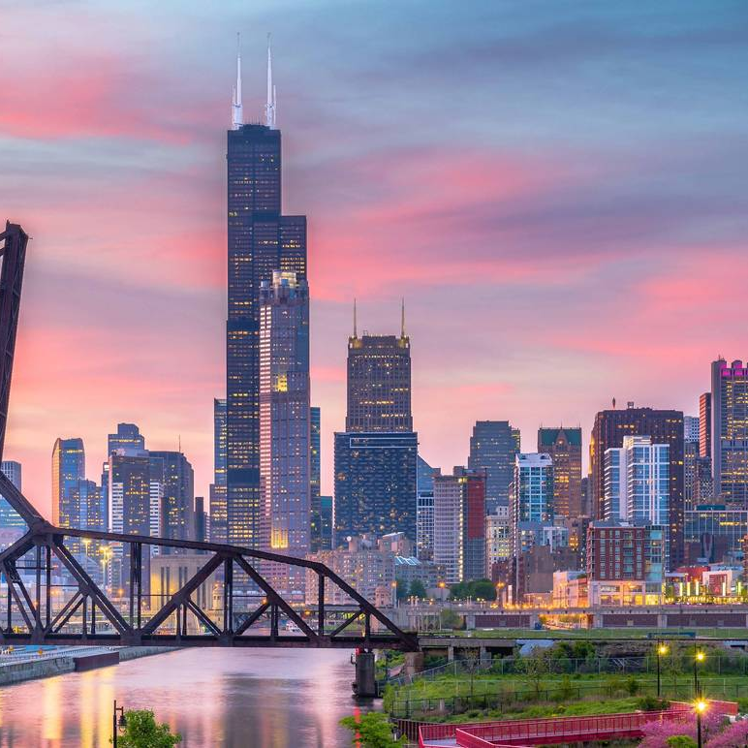
A TALE OF TWO CITIES
EXAMINING CRIME AND ARREST RATES IN THE COMMUNITY AREAS OF CHICAGO, IL
LLO-8200 Data Science
Final Presentation - April 6, 2021
Amrita Bhowmick, Jessica Edonick, Tammie Emuron, Michael Kabbaz
Notes:
Notes:
Hello! Tonight, we bring you the tale of two cities….both of which are Chicago, Il.
The goal of our project was to explore relationships between communities, crime, and arrests.
As you’ll soon see, we found significant variation between communities, and even stronger relationships between variables than we had expected.
These variations raise concerns related to equity and justice.
Image Source Links (across all slides)
https://www.timeout.com/chicago/things-to-do/most-amazing-views-in-Chicago
20f24bda-013c-4810-a58c-96dc3ea9ad9c-CHICAGO_CRIME_GUN_VIOLENCE.JPG (3001×1680) (gannett-cdn.com)
https://mk0lassoio1mfe7o7ojj.kinstacdn.com/wp-content/uploads/2019/11/bigstock-Chicago-Skyline-Aerial-Drone-V-294863011.jpg
https://www.chicagotribune.com/entertainment/museums/ct-ent-visual-arts-review-2020-equity-isolation-1206-20201202-y2mblfzjqvbovf5zricdodv5ga-story.html
https://fansided.com/2013/08/16/chicago-bears-quarterback-matt-blanchard-fractures-knuckle/
https://www.pinterest.com/pin/465418942734820268/
https://bleacherreport.com/articles/2817546-jabari-parkers-fairytale-chicago-return-headed-quickly-toward-unhappy-ending
https://sbisoccer.com/2019/07/sbi-uswnt-woman-of-the-match-alyssa-naeher
https://bleacherreport.com/articles/2377347-will-derrick-roses-injury-lead-chicago-bulls-back-to-nate-robinson
https://arrestjustice.wordpress.com/appendix/cpd-district-community-area-map/
https://www.insightintodiversity.com/apprentice-network-creates-a-pipeline-of-diverse-talent-in-chicago-and-leaders-hope-to-expand-it/
https://www.choosechicago.com/articles/tours-and-attractions/navy-pier/
https://www.theinterngroup.com/our-blog/9-unforgettable-chicago-quotes/
https://en.wikipedia.org/wiki/Navy_Pier
https://en.wikipedia.org/wiki/Theater_in_Chicago
https://news.uchicago.edu/story/closer-look-how-neighborhoods-shape-public-health
Chicago-Illinois.jpg (2560×1600) (thewowstyle.com)
el chicago - Bing images
https://www.google.com/url?sa=i&url=https%3A%2F%2Fwww.vectorstock.com%2Froyalty-free-vector%2Fthe-elevated-train-in-chicago-vector-8732712&psig=AOvVaw2YVZImlD0uAzNUubGA7x7y&ust=1616983850429000&source=images&cd=vfe&ved=0CAIQjRxqFwoTCKCI7LL00e8CFQAAAAAdAAAAABAD

Slide 2


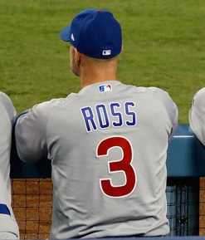
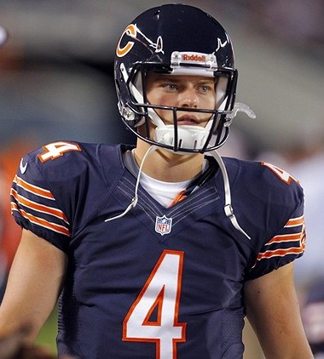
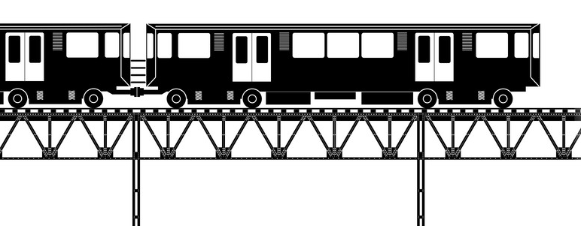
TODAY’S STOPS
MODELING & VALIDATION
ANALYSIS & FINDINGS
LIMITATIONS
IMPLICATIONS & NEXT STEPS
Q&A
BACKGROUND & PROBLEM OF PRACTICE
RESEARCH QUESTIONS & HYPOTHESIS
PROCESS & ANALYTICAL PLAN
DESCRIPTIVE STATISTICS
Notes:
Notes:
The flow of our presentation will be as follows:
First I will provide background, lay out the problem of practice, and go over our research questions and hypothesis.
Next, Michael will present our process and analytical plan, and our datasets and descriptive statistics.
Then, Amrita will review our modeling, validation, and findings.
Finally, Jessica will discuss the study’s limitations, implications, and possible next steps.
We’ll then be happy to take any questions that you might have.
Now on to our first stop!

Slide 3
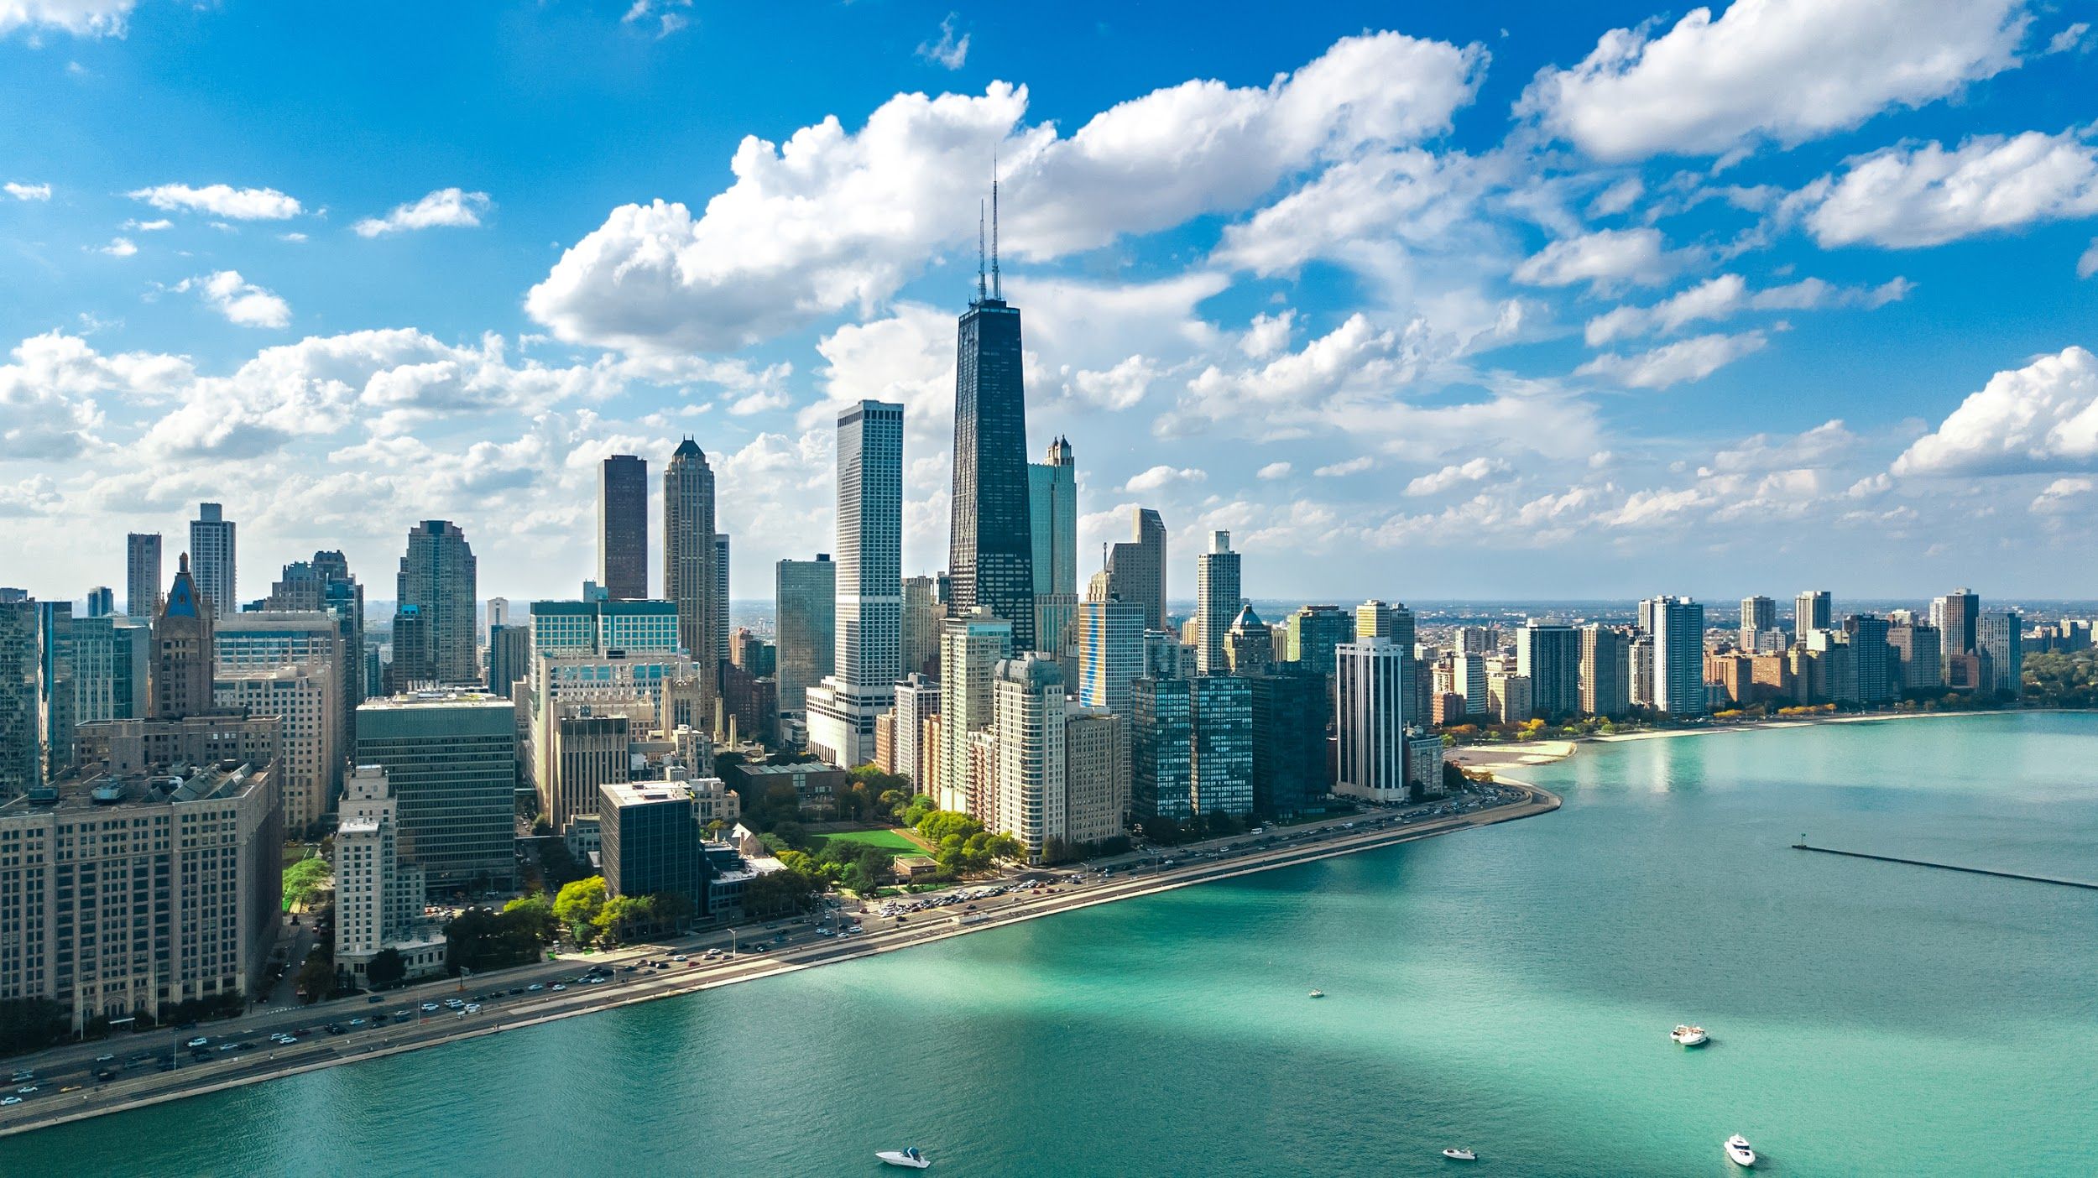
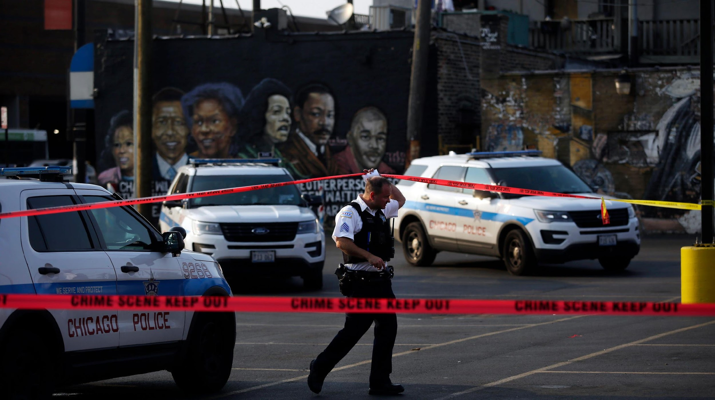
PROBLEM OF PRACTICE
“It was the best of times, it was the worst of times...it was the season of light, it was the season of darkness, it was the spring of hope, it was the winter of despair.”
- Charles Dickens, A Tale of Two Cities
Notes:
Notes
This quote from A Tale of Two Cities may look familiar!
It comes from a different context, but we feel it resonates with our problem of practice.
The problem is this: how safe you are, and whether you get justice shouldn’t vary by which neighborhood you live in, but in many US Cities, it does, and significantly so.
We set out to understand how this manifests in Chicago what factors can help explain and/or predict it.
Sources:
https://www.goodreads.com/work/quotes/2956372-a-tale-of-two-cities

Slide 4
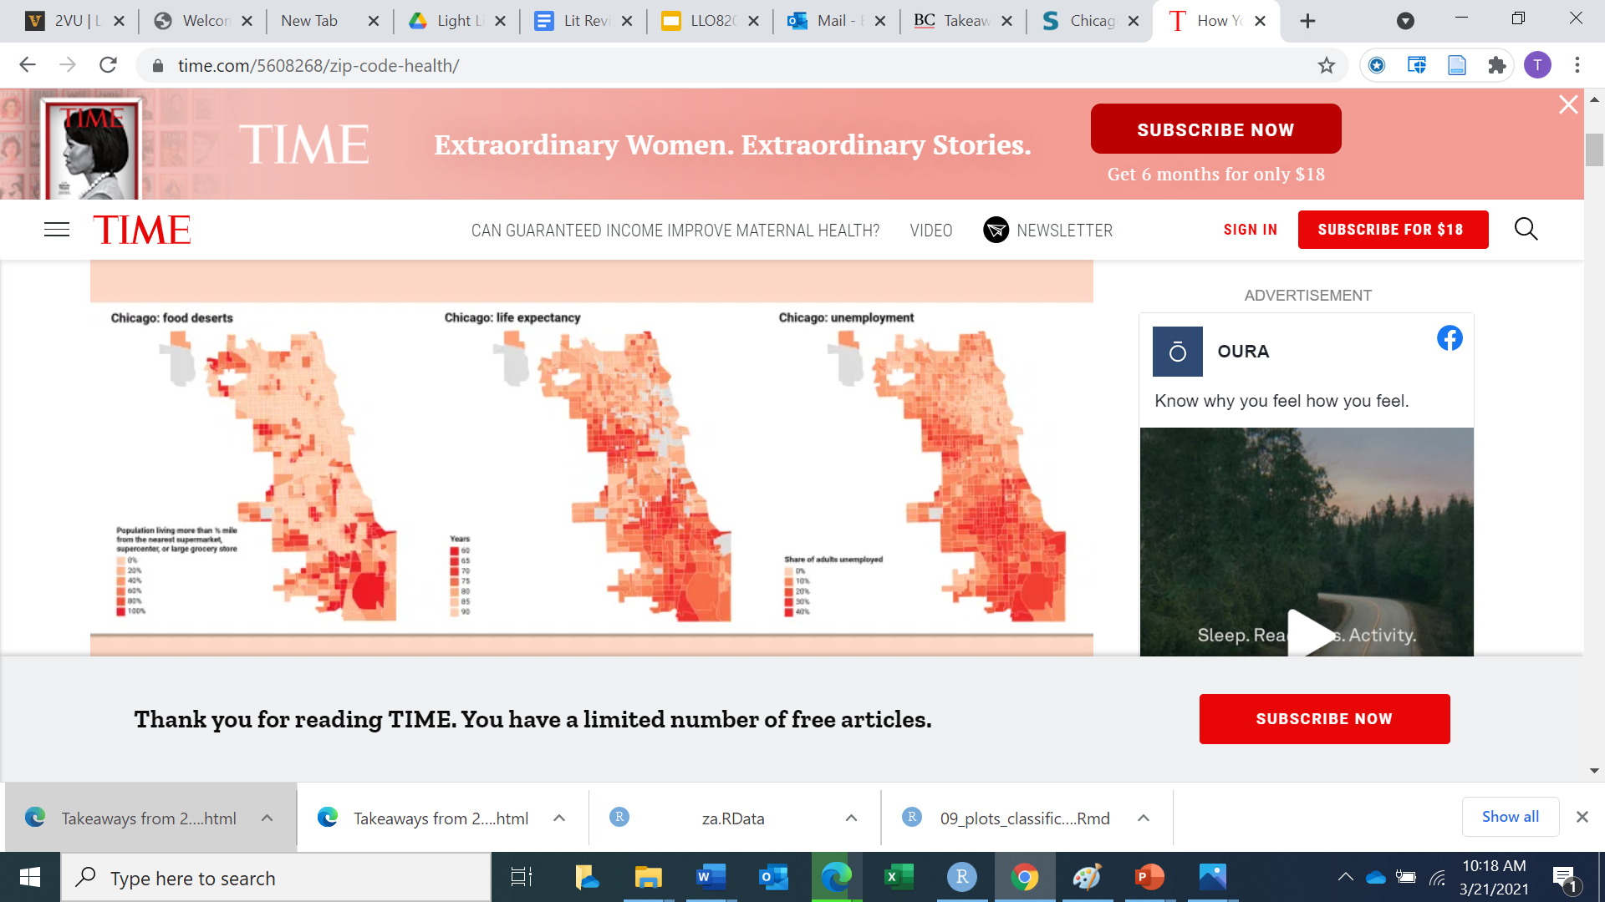
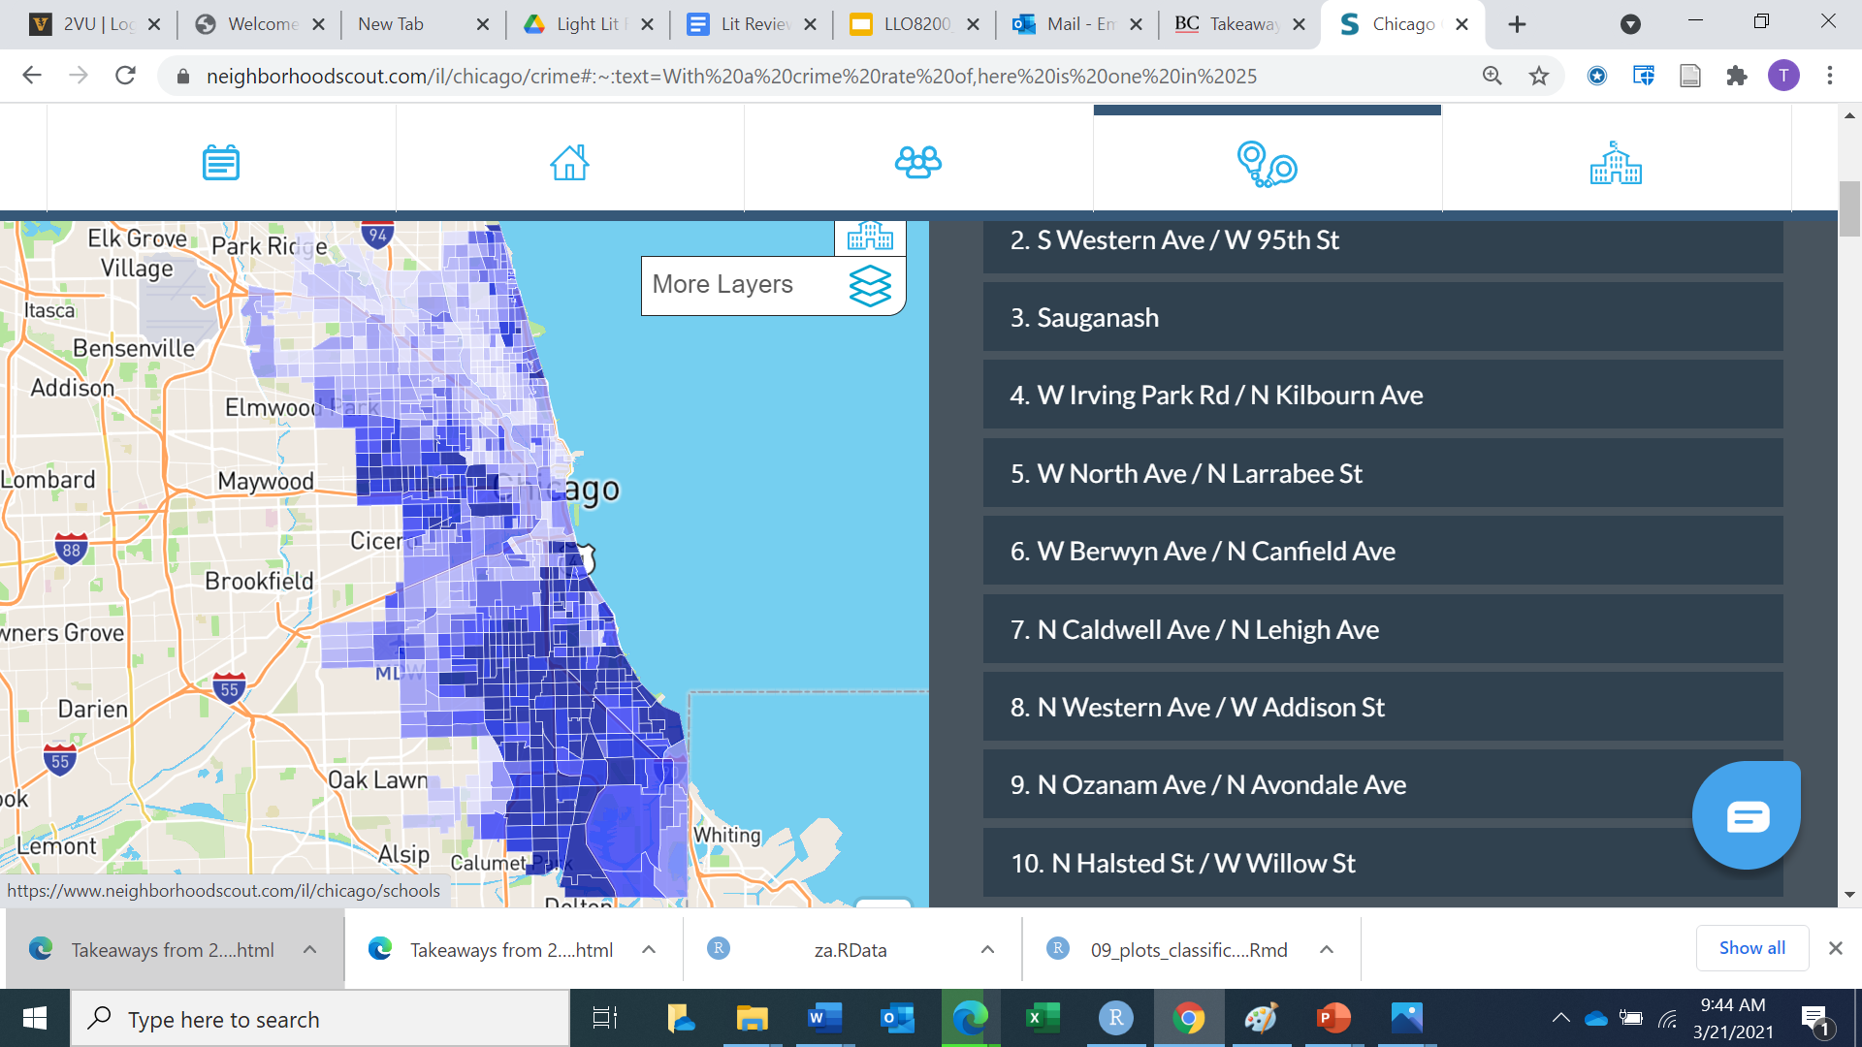
WHY IT MATTERS
“Researchers...find that 56 of the U.S.’ 500 largest cities are home to people who can expect to live at least 20 fewer years than those in other neighborhoods, even if they’re just blocks or miles away”
Time Magazine
Chicago Crime
4
Notes:
Notes:
In many US cities life expectancy varies hugely in the space of a few blocks.
We will reveal our own heat map later, but in the meantime, these two from external sources show the great variability in life expectancy and crime across Chicago.
There is a stunning similarity between the areas in dark orange, with the lowest life expectancy, and those in dark blue, with the highest levels of crime.
This begs the question “what is going on?”
The news articles and literature we reviewed suggested numerous factors that could potentially be at play, including racial segregation, poverty, housing costs, unemployment and lack of social services, which tend to disproportionately affect certain neighborhoods.
Sources
https://www.neighborhoodscout.com/il/chicago/crime#:~:text=With%20a%20crime%20rate%20of,here%20is%20one%20in%2025
On the Origins of the Violent Neighborhood: A Study of the Nature and Predictors of Crime-Type Differentiation across Chicago Neighborhoods
https://time.com/5608268/zip-code-health/
Why Is There More Crime in Cities?
Crime, the Criminal Justice System, and Socioeconomic Inequality (aeaweb.org)

Slide 5
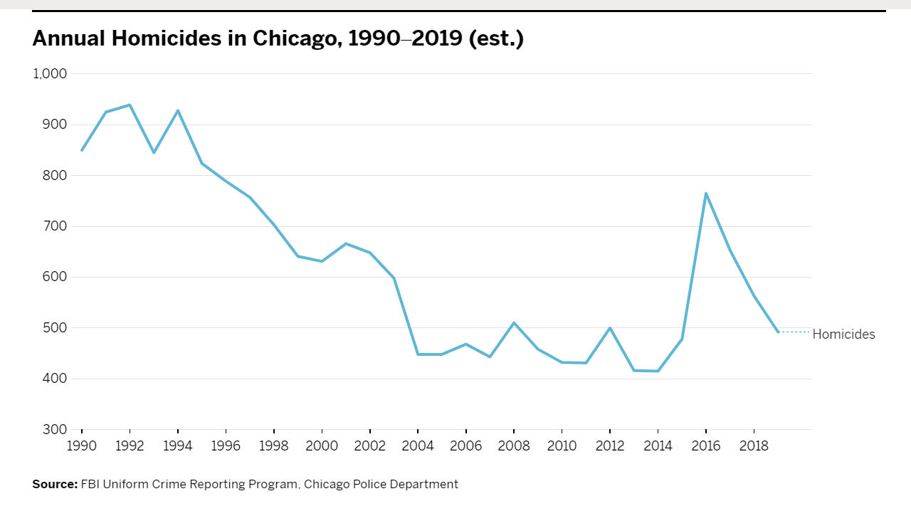
CRIME IS TRENDING DOWN BUT...
“The most disturbing feature of the 2016 spike is that we’re not catching anybody…."
Policing
Crime rate 3X
the national average
Inequity
“The CPD’s...algorithms not only failed to accurately predict violent crime but endangered...civil liberties and exacerbated racial disparities.”
Racism
Racial Threat Theory: “threatening” Black population, law enforcement actions, social control.
“$1.6 Billion in spending on 13,000 Police. Is it worth it?”
Notes:
Notes
In terms of overall trends, Chicago homicides are down since 1990.
However, they plateaued in the 2010s, and spiked in 2016.
At that time, poor arrest rates further exacerbated crime, as gun ownership and retaliatory violence surged.
Currently, Chicago’s crime rate is three times the national average and starting to trend up again.
In the face of this, there have been issues with policing. A 2012 review of the CPD’s surveillance system found that flawed crime prediction algorithms led to infringement on civil liberties and racial injustices.
This is not for a lack of spending on police, prompting citizens groups to question how resources are being invested.
Perhaps Data Science can shed some further light on these issues!
CUT FOR TIME
The quote from Sociologist Wesley Skogan who noted that the abysmal arrest rates, hindered the ability of the CPD to deter crime, as people “felt the need to protect themselves by carrying a weapon, adding more guns on the streets and encouraging retaliatory violence.”
Indeed, crime in Chicago is still three times the national average, and there were a stunning 769 murders in 2020 alone.
Racial Threat theory describes a phenomenon whereby black populations are seen as more threatening and therefore subject to heavier police action, which manifested in Chicago.
LITERATURE notes that crime rates have been used a predictor of the quality of a community or “hot spots”, where investment in technology, business, careers, education and crime prevention are placed emphasizing “structured silences”, or our inability to hear the voice and document the experiences of traditionally underserved populations. I DONT”T GET HOW THIS RELATES
, and there were 769 homicides in 2020 alone.
Sources
https://www.injusticewatch.org/news/2020/chicago-police-staffing/

Slide 6
OUR STUDY: HYPOTHESIS AND RESEARCH QUESTIONS
RESEARCH QUESTIONS
In Chicago, there is a relationship between community area and crime rate and violent crime rate, and between community area and arrest rates
Is there a relationship between Community Area and Crime Rate? and Violent Crime Rate? And Arrest Rate?
Is there a relationship between Community Area and Crime Rate? and Type of Crime? And Arrest Rate?
Can Community Area predict Crime Rate? Type of Crime? Arrest Rate?
If so, does considering variables such as Median Income, Race, Level of Educational Attainment, and/or Employment Rate improve predictive power of the model?
Can Community Area predict Crime Rate? Type of Crime? Arrest Rate?
HYPOTHESIS
Is risk evenly shared? Is justice evenly delivered?
Notes:
Notes
Against that backdrop, we wanted to look at:
1) The relationship between community area and crime rate, type of crime (violent or nonviolent), and arrest rate.
2) Whether community area could predict these, and
3) What would happen when we considered other variables.
This evening, we will focus mainly on crime rate, but we will highlight a few interesting findings in the other areas as well.
Based on the literature , we thought that higher income, education, and employment in a given community would likely correlate with lower crime, and higher arrest rates.
Our big picture question was whether risk is evenly shared, and whether justice is evenly delivered among Chicago’s residents

Slide 7
SECOND STOP
MODELING & VALIDATION
ANALYSIS & FINDINGS
LIMITATIONS
IMPLICATIONS & NEXT STEPS
Q&A
BACKGROUND & PROBLEM OF PRACTICE
RESEARCH QUESTIONS & HYPOTHESIS
PROCESS & ANALYTICAL PLAN
DESCRIPTIVE STATISTICS
Notes:
Notes:
Now onto our next stop! Michael will discuss our process and analytical plan, and provide descriptive statistics to familiarize you with our dataset.

Slide 8

PROCESS AND ANALYTICAL PLAN
Data Cleaning and Transformations
Exploratory Analysis
Building Initial Model
Validation
Refining Model
Plotting and Data Visualization
Notes:
SPECIFICALLY WHAT DID AND WHAT INTERESTING
Notes:
This shows our overall process as we began developing our model. As described, we first engaged in data cleaning and transformations, and did some exploratory analysis to better understand the patterns within, and to identify possible relationships.
We then began building, validating and refining our model, and visualizing the results, which we’ll discuss further in the next section.
Some of the key functions we used for our analysis included conditional means, correlation analysis, and logistic regression and probabilities.

Slide 9
PROCESS & ANALYTICAL PLAN
Datasets for Analysis
Reviewed Chicago crime data from 2001 to current
Includes over 7 million records
Each unit of analysis represents a reported incident
Created an investigative dataset extrapolated from the full dataset that was more recent (2015) and provided time lag for the crimes to be updated and potentially closed (2018)
Joined other external data sources that provided insights and context to location in the city
Community Data (i.e., “Chicago 77”) coupled with other relevant demographics often associated with crime (e.g., income, race/ethnicity, employment, and education)
Data Sources:
Chicago Police Department's CLEAR
(Citizen Law Enforcement Analysis and Reporting) system https://data.cityofchicago.org/
Chicago Metropolitan Agency for Planning (CMAP) - Community Data Snapshots, including 2014-2018 American Community Survey five-year estimates https://www.cmap.illinois.gov/
Notes:
Notes:
First we found a dataset from the City of Chicago. It covered the four year from 2015-2018, and contained over 1.0 million crime records.
Each record documented and incident. Community Area was one of the variables, as was whether an arrest had occurred, and the uniform FBI code for the crime. We used the code to mutate in a new variable, categorizing each crime as either violent or nonviolent.
Because we wanted to be able to run analysis by Community Area that considered other characteristics of each Community, such as population, income, race, employment and education.
We created another dataset using the Community Data Snapshots from the American Community Survey data. These snapshots provided averages covering the period 2014-2018.
We then joined two datasets, which allowed us to use the population data to mutate in new variables: crime rate, violent crime rate, arrest rate.

Slide 10
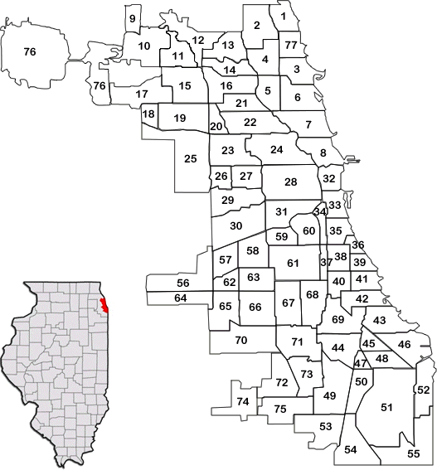
PROCESS & ANALYTICAL PLAN
Datasets
Chicago Crime Record Level Data
The Datasets
Chicago Police Department
~1.0 million crime records 2015-2018
Community Data Snapshots
77 Community Area Profiles, American Community Survey Data
2014-2018
“Chicago 77” Communities
Community Area Community Population Median_Income White Hispanic Black Asian Other Percent_Employed Percent_Bachelors_Above
ID Case Number Date Block IUCR Primary Type Description Location Description Arrest Domestic Beat | District Ward Community Area FBI Code X Coordinate Y Coordinate Year Updated On Latitude Longitude Location
Source: https://libguides.luc.edu/Social_Work

Slide 11
DESCRIPTIVE STATISTICS
Basic Counts and Means - CPD Dataset (2015 to 2018)
Variable | Definition | Count/Rate
Crime Records | # of crime incidents in the 2015-2018 data set (unit of analysis) | Count: 1,048,575 Mean/Yr: 262,509
Crime Rate (Crime per Pop) | # Crimes/Community Area Population | Mean: .54 Min/Max: .09 / 1.43
Violent Crime Rate | Categories of FBI Uniform Crime Reporting (UCR) includes murder and nonnegligent manslaughter, rape, robbery, and aggravated assault (violent crimes). Violent Crime % by Community Area | #: 154,681 (14.8%) Min/Max: 2.8%/19.6%
Arrest Rate | Arrests = Y/N Arrest rate = # crimes /# of arrests | # of arrests: 224,904 Arrest rate: 21.4%
Of the 224,904 total arrests, 206,131 were for non-violent reported crimes. In other words, of the 154,681 violent crimes reported, only 18,773, or 8.3% resulted in an arrest from 2015 to 2018.
Notes:
Notes:
One of the first things we did after the initial cleaning and transformation was to do some basic counts and calculate some means. These are shown in this table.
We then wanted to look at these more closely to see if there was variation across time, or by community area.

Slide 12
DESCRIPTIVE STATISTICS
Basic Counts and Means - Community Survey Dataset (2014-2018)
Variable | Definition | Count/Rate
Community Area | Official Chicago designation for neighborhoods | Count: 77
Population | Total # of people per Community Area Highly variable by Community Area | Mean: 35,294 Min: 2,336 / Max: 100,547
Median Income | Average household income 2014-2018 by Community Area | Mean: $53,313 Min: $13,518 / Max: $115,756
Race/Ethnicity | %: White non Hispanic, Black non Hispanic, Hispanic/LatinX, Asian non Hispanic, Other by Community Area. Highly variable by Community Area | Min% white: <1% Max% white: 84%
Educational Attainment | % population that completed bachelor’s or higher by Community Area. Highly variable by Community Area. | Mean: 31% Min: 4% / Max: 86%
Percent Employed | Of those in the workforce,% employed by Community Area. Somewhat variable by Community Area | Mean: 84% Min: 67% / Max: 98%
Notes:
Notes:
One of the first things we did after the initial cleaning and transformation was to do some basic counts and calculate some means. These are shown in this table.
We then wanted to look at these more closely to see if there was variation across time, or by community area.

Slide 13
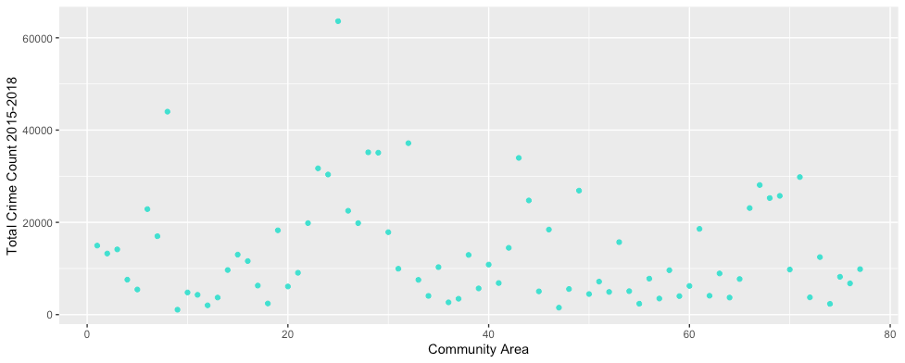
DESCRIPTIVE STATISTICS
Total Crime Count by Community Area: 2015 - 2018
Rogers Park (Community Area #1), with a population of 54,872 had 14,968 crimes reported from 2015 to 2018.
Woodlawn (Community Area #42), with a population of 22,925 had 14,477 crimes reported from 2015 to 2018.
Mean: 13,618
Min: 1,068 Max: 63,602
Reported crime counts from 2015-2018 varied significantly across Community Areas, including areas with similar sized populations.

Slide 14
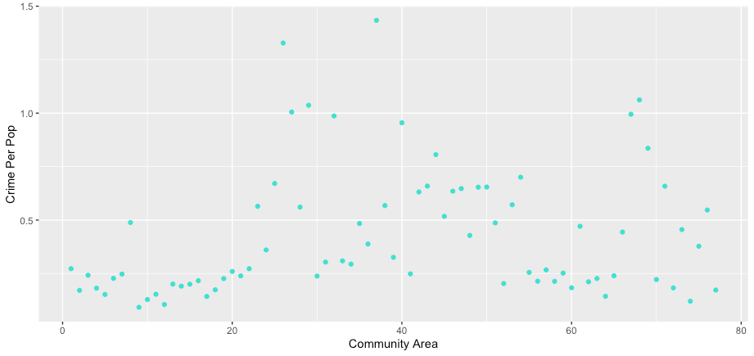
DESCRIPTIVE STATISTICS
Crime Per Population by Community Area: 2015 - 2018
Edison Park (Community Area #9), with a population of 11,567 had 1,068 crimes reported from 2015 to 2018, or .09 reported crimes per person during that time period.
Fuller Park (Community Area #37), with a population of 2,399 had 3,440 crimes reported from 2015 to 2018, or 1.43 reported crimes per person during that time period.
Mean: .54
Min: .09 Max: 1.43
Crime Per Population rates varied greatly by Community Area, including considerable variation between similarly populated areas and # of crimes reported.

Slide 15
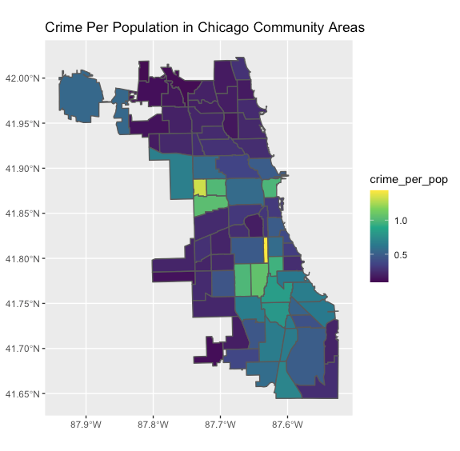
COMMUNITY AREA HEAT MAP BY CRIME PER POPULATION
Edison Park (Community Area #9), with a population of 11,567 had 1,068 crimes reported from 2015 to 2018, or .09 reported crimes per person during that time period.
Fuller Park (Community Area #37), with a population of 2,399 had 3,440 crimes reported from 2015 to 2018, or 1.43 reported crimes per person during that time period.
A stark contrast illustrating the tale of two cities.

Slide 16
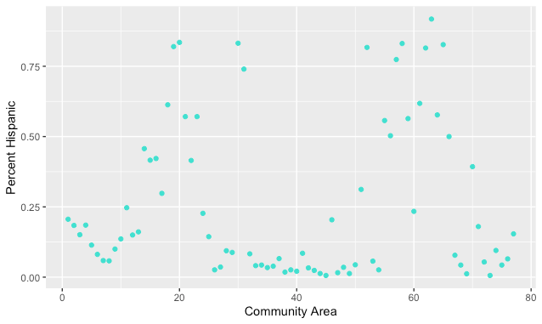
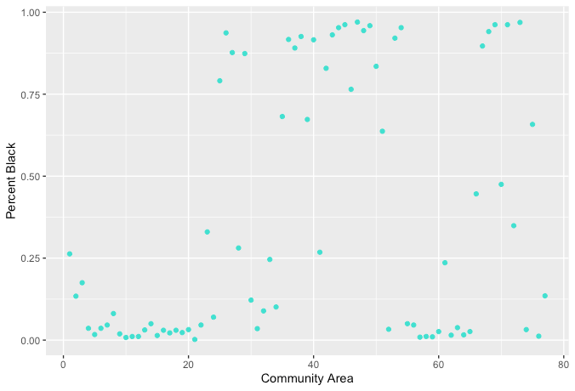
DESCRIPTIVE STATISTICS
Hispanic and Black Percentage by Community Area: 2015-2018
Hispanic Percentage
Black Percentage
Mean: 26.4%
Min: < 1% Max: 91.8%
Mean: 37.9%
Min: < 1% Max: 97%
Community Areas tend to be segregated even across non-white racial/ethnic groups.
Notes:
Notes:

Slide 17
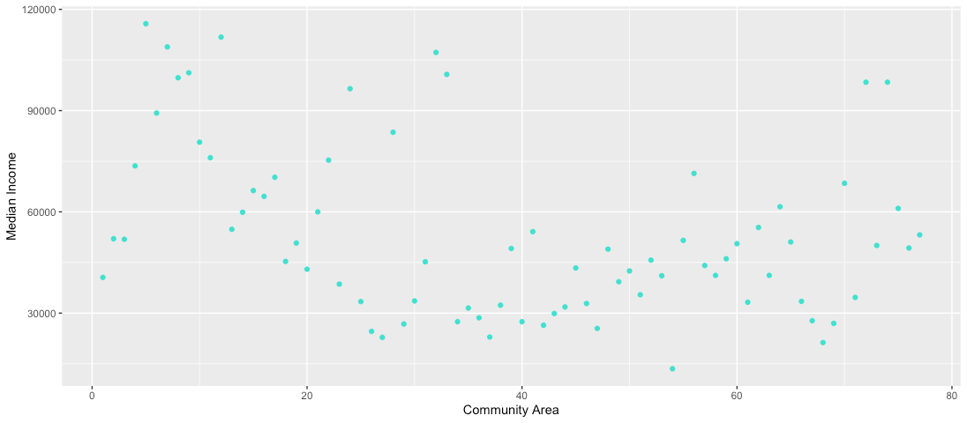
DESCRIPTIVE STATISTICS
Median Income by Community Area: 2015-2018
Mean: $53,313
Min: $13,518 Max: $115,756
Median Incomes varied significantly across Community Areas.
Notes:
Notes:

Slide 18
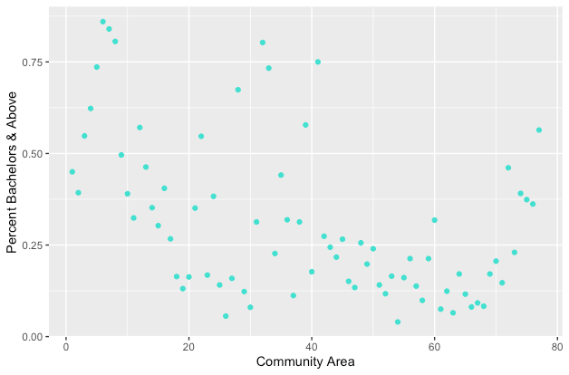
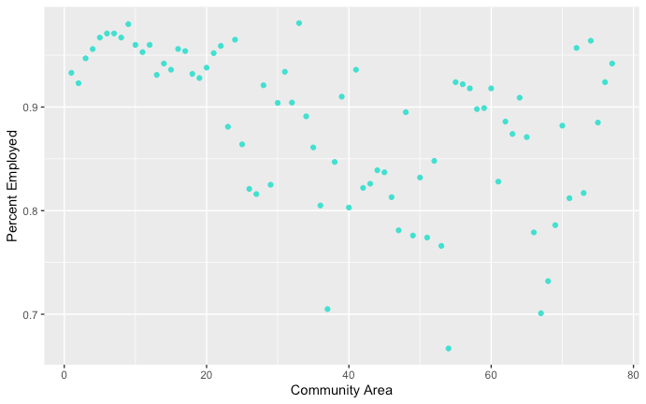
DESCRIPTIVE STATISTICS
Bachelor's Degree and Above & Employment by Community Area: 2015-2018
Bachelor’s Degree and + Percentage
Employment Percentage
Mean: 31.2%
Min: 4% Max: 86%
Mean: 88.3%
Min: 66.7% Max: 98.1%
Considerable variation exists between Bachelor’s Degree and Above & Percentage Employed by Community Area.
Notes:
Notes:

Slide 19
THIRD STOP
MODELING & VALIDATION
ANALYSIS & FINDINGS
LIMITATIONS
IMPLICATIONS & NEXT STEPS
Q&A
BACKGROUND & PROBLEM OF PRACTICE
RESEARCH QUESTIONS & HYPOTHESIS
PROCESS & ANALYTICAL PLAN
DESCRIPTIVE STATISTICS
Notes:
Notes:
Next stop! Amrita will now explain how we validated our model, and share the findings from our analysis.

Slide 20
MODELING & ANALYSIS
Identification of Independent and Dependent Variables
Potential Dependent Variables
Crime Per Population (Crime Rate)
Violent Crime Rate
Arrest Rate
Key Analyses
Conditional Means
Correlation Analysis
Logistic Regression & Probabilities
Potential Independent Variables
Crime Per Population
Median Income (Income Thirds)
Race
Employment Rate
Educational Attainment
Violent Crime Rate
Arrest Rate
Crime Rate was identified as the key Dependent Variable. Median Income, Race, Employment Rate, and Educational Attainment were identified as the key Independent Variables
Notes:
We identified a wide variety of potential dependent and independent variables. After running a variety of analyses on this data, Crime per Population was identified as our primary Dependent Variable. Median Income, Race, Employment Rate, and Educational Attainment were identified as key Independent Variables.

Slide 21
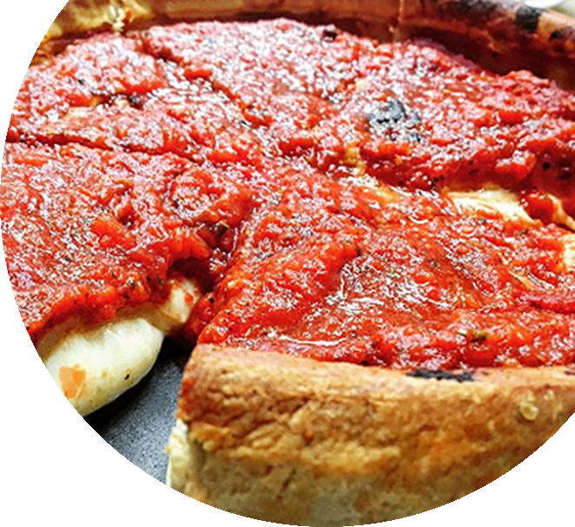
MODELING AND REGRESSION RESULTS
Model Selection
R-Squared
Dependent Variable
Independent
Variables
Crime Rate
(Crime Per Population)
Median Income
(Thirds)
% Black Population
% Hispanic Population
55%
Crime Rate
(Crime Per Population)
Median
Income
(Thirds)
% Bachelors or Above
% Employed
58%
Crime Rate
(Crime Per Population)
Median
Income
(Thirds)
% Black Population
% Hispanic Population
% Bachelors or Above
% Employed
61%
61% of the Crime Rate (Crime per Population) can be explained by income, % of Black & Hispanic populations, % of residents with a bachelor's degree or above, and % of residents who are employed
Notes:
Notes:
Modeling: Based on our exploratory data analysis, we wondered, what’s contributing to this variability?
With crime rate per population as the dependent variable, we experimented with models that included various combinations of the independent variables
The linear regression model that we ultimately settled on found that income, race, education level, and employment can explain 61% of Crime Rate.

Slide 22

CROSS-VALIDATION OF THE MODEL
Confusion Matrix Results - Accuracy = 84%
Sensitivity = 87.5%
Specificity = 82.5%
Testing and Training Approach (Kfold=10)
Results (RMSE)*:
Test
Train
Min | 1st Quartile | Median | Mean | 3rd Quartile | Max
.1872 | .1875 | .1877 | .1878 | .1880 | .1884
The model results in a RMSE of 19%. While this leaves some room for improvement in terms of predictive accuracy, the model performs consistently across data sets.
25
*Crime Rate Range Set to 0-1
Notes:
Notes:
Validation: Crime rate was set to a 0-1 scale for both the predictive and actual variables. We initially ran a confusion matrix to assess sensitivity and specificity of our selected model
After this point, we ran a kfold analysis to test our model with 10 datasets
The resulting RMSE consistently stays around 19% - The model could be better in terms of accuracy, but is consistent when applied to varied datasets

Slide 23
LAST STOP
MODELING & VALIDATION
ANALYSIS & FINDINGS
LIMITATIONS
IMPLICATIONS & NEXT STEPS
Q&A
BACKGROUND & PROBLEM OF PRACTICE
RESEARCH QUESTIONS & HYPOTHESIS
PROCESS & ANALYTICAL PLAN
DESCRIPTIVE STATISTICS
Notes:
Notes:
Last stop! Jessica will recap the key findings, discuss the limitations and implications os, and possible next steps for further study and action based on the data, and then we’ll have some Q&A.

Slide 24

LIMITATIONS
Turning the River Green - Richness of Data
Arrest Rate
Violent Crime
Other Socio-cultural factors?
Notes:
Notes:
Working through 1.0+ million entries in data was a blessing given the diversity, breadth and depth of the information provided from various sources, but the large amounts of data also became a burden when it came to honing in on specific covariates in which to study.
Although fascinating, arrest rate is an independent variable which needs more investigation, and became a challenging variable on which to run regression analysis. Median income is statistically significant as it relates to arrest rate e.g. the arrest rate is higher in more affluent communities, however, since the arrest rate is small overall, one in five crimes, our linear models did not show significance beyond median income for other variables on arrest rate.
We also looked at violent crime levels based on the FBI Crime Uniform Definitions to see what covariates might contribute to predicting violent crime in community areas. We did run some initial predictive models for violent crime, but given the scope of our analysis, and the data being so dispersed, we decided to focus on crime rate overall.
Since our r-squared is 61% when looking at income, % Black/Hispanic, % employed, and educational attainment we can explain this portion of the crime rate with these factors, however, there are clearly other socio-cultural factors which could be influencing crime rate, as an example the number of single parent homes or individuals who are not in the job market and are therefore not tracked as employed or unemployed. Pulling in a variety additional socio-cultural variables like those mentioned and testing them through our linear model would be an area for further research.
Naturally, we were also limited by our own time/resourcing constraints. There may also be additional ways to group/categorize our data to better drill down into specific variables.

Slide 25

IMPLICATIONS & NEXT STEPS
Implications
Next Steps
Possible levers: education, employment
Targeting of interventions: by Community Area
Further data analysis
Advocacy, decision making, policy to promote public safety, equity and justice
(Policing Reform, Prevention)
“Our strategy...will focus on improving all areas of the department...with the goal of improving public safety for every resident and visitor on every block.”
Chicago Police Supt. David Brown, 2020
Notes:
Notes:
Some key takeaways to impact change
We can’t change race, of course….But we can affect employment and education → Which could (we can’t say “will” because correlation not causation) impact crime rates
Based on the full linear model presented, we can see the strength of the relationship between median income levels, race, education level and employment on crime in various Chicago neighborhoods.
Since median income and race are two of the largest predictors of crime and make-up the greatest variance in the linear model, the City of Chicago and the CPD could work together with community organizations in each neighborhood to understand the educational and employment opportunities within family units, schools and businesses in increase levels of median incomes thereby reducing crime.
Furthermore, the CPD can also use this predictive model to better understand community dynamics and their own bias as it relates to income level and race in order to develop and implement policing practices with appreciation, respect and support each neighborhood and their unique needs. Already the CPD is working to the end in this quote from Supt. David Brown, “Our strategy moving forward will focus on improving all areas of the department guided by five key pillars with the goal of improving public safety for every resident and visitor on every block throughout the city” (Chicago NBC, 2021).

Slide 26
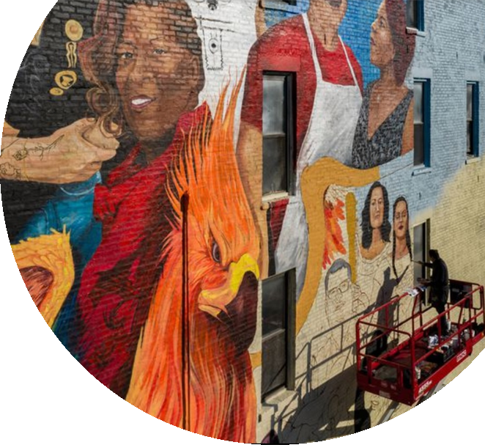
HOPE FOR A FUTURE TALE OF ONE (SAFE, EQUITABLE) CITY
“I see a beautiful city and a brilliant people rising…
I see the lives...peaceful, useful, prosperous and happy. I see...a sanctuary.”
Charles Dickens, A Tale of Two Cities
Image: Artist Pablo Serrano paints a mural of residents and essential workers in Chicago's Pilsen neighborhood, Oct. 30, 2020
Notes:
Notes
We wanted to leave you with a parting quote and image.
To wrap up our tale of two cities (of Chicago) we wanted to share a community developed mural that demonstrates the hopes, vision and desire for respectful connections.
Crime influences how a community envisions itself internally and how it is viewed externally by policy makers, businesses and law enforcement.
Data driven decisions can support community development, support and access to resources in Chicago especially around education and employment, which can lead to a safer and equitable experience where community members can express themselves and build a future together.

Slide 27
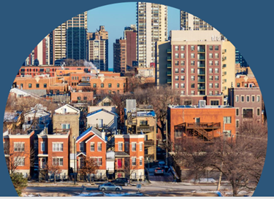
THANK YOU!
Questions?
Notes:
Notes:
Thank you very much for listening to our tale of two cities! We’ll now open it up to your questions.

Slide 28
APPENDIX

Slide 29
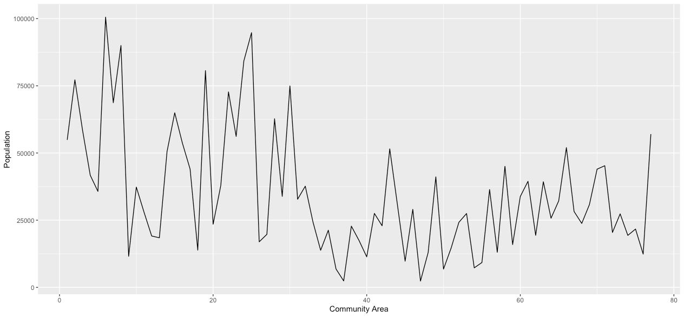
DESCRIPTIVE STATISTICS
Population by Community Area: 2015 - 2018

Slide 30
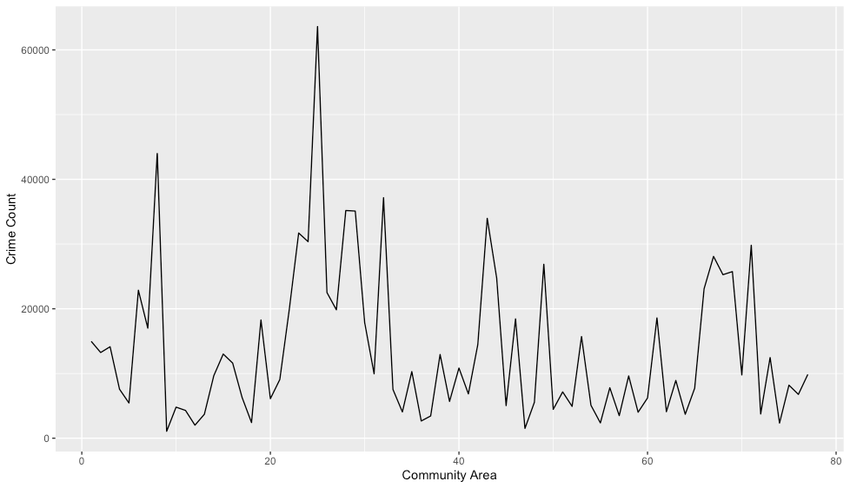
DESCRIPTIVE STATISTICS
Total Crime Count by Community Area: 2015 - 2018
Notes:
Notes:

Slide 31
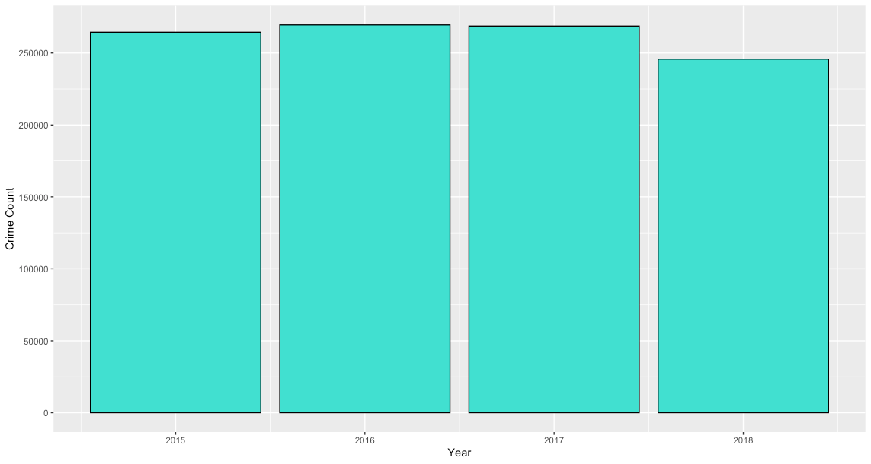
DESCRIPTIVE STATISTICS
Crime Count by Year
Crime counts per year did not vary significantly by year
Notes:
Notes:
Here is the plot of crime counts by year. We did not find there to be very notable variation by year. (We also looked at the days of the week, and did not find notable variation there. .

Slide 32
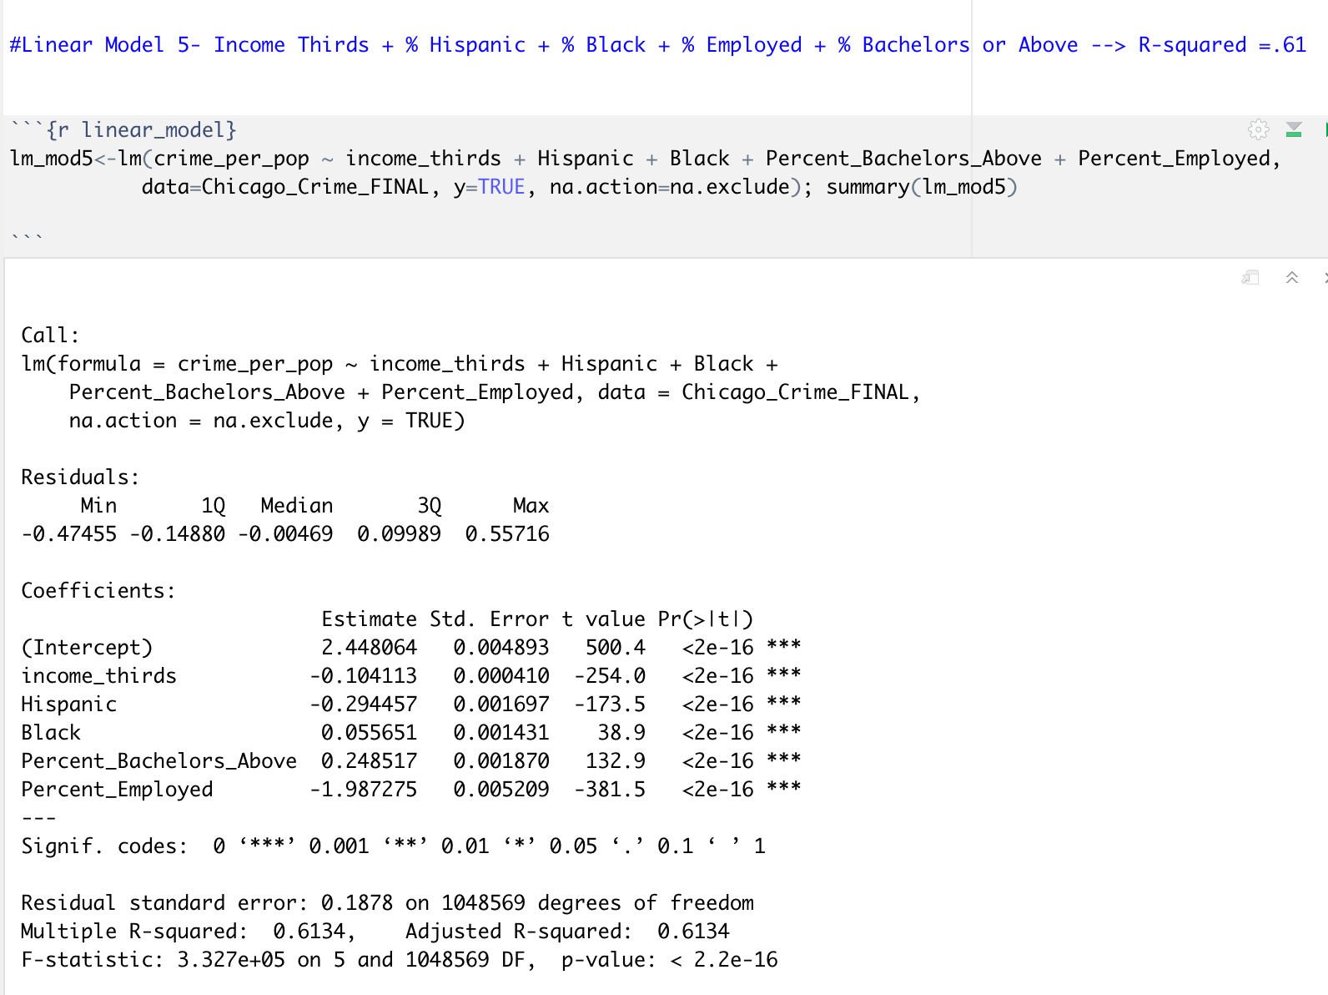
APPENDIX: LINEAR MODEL #5

Slide 33
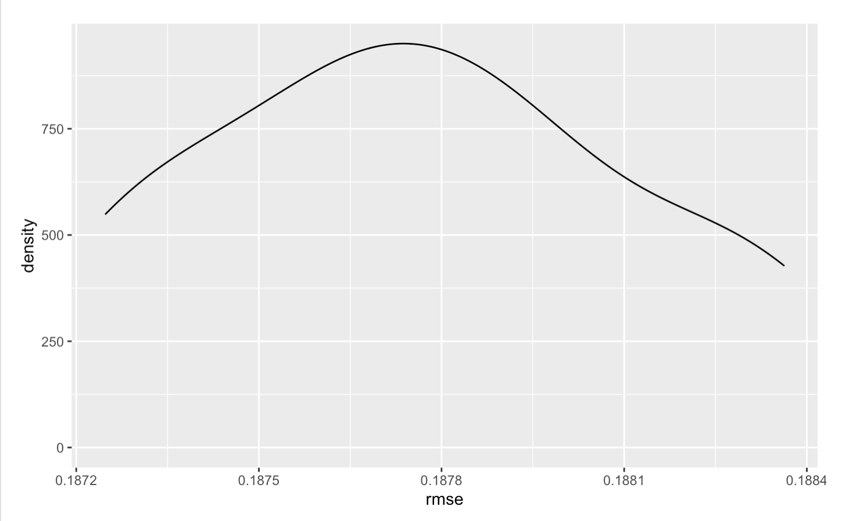
APPENDIX: CROSS VALIDATION & RANGE OF RMSE
Min | 1st Quartile | Median | Mean | 3rd Quartile | Max
.1872 | .1875 | .1877 | .1878 | .1880 | .1884

Slide 34
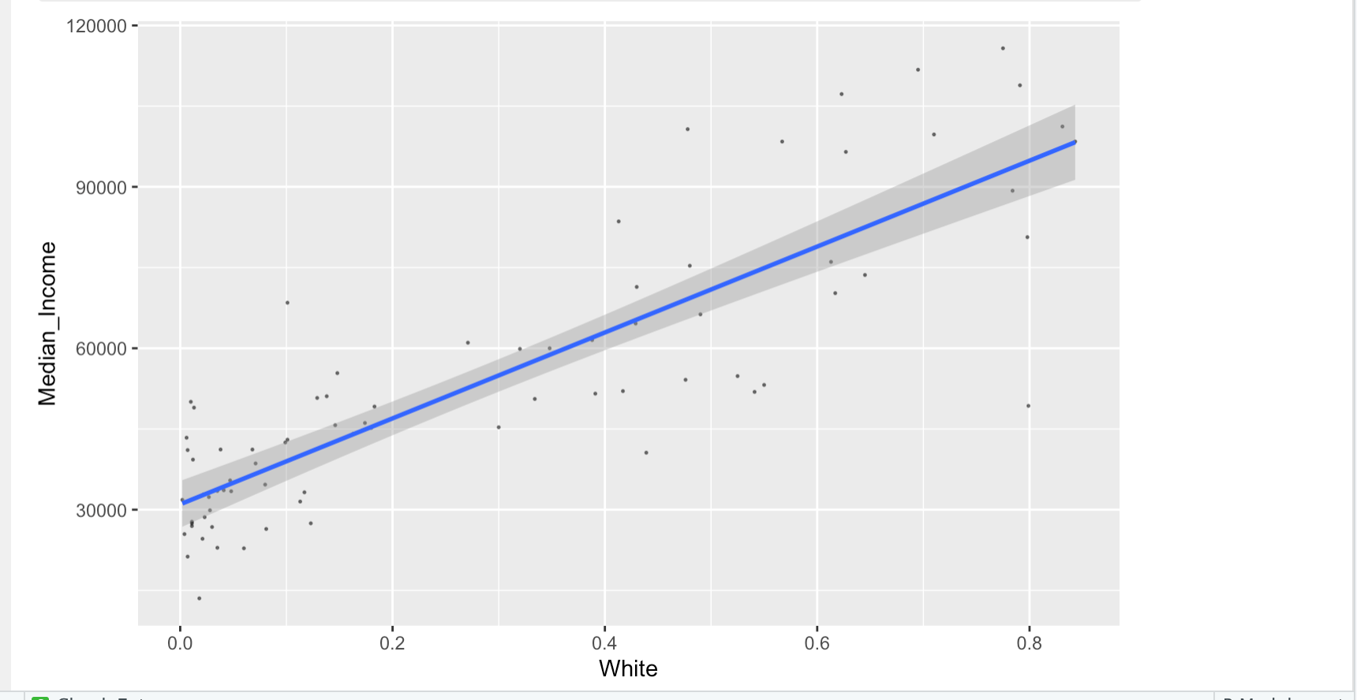
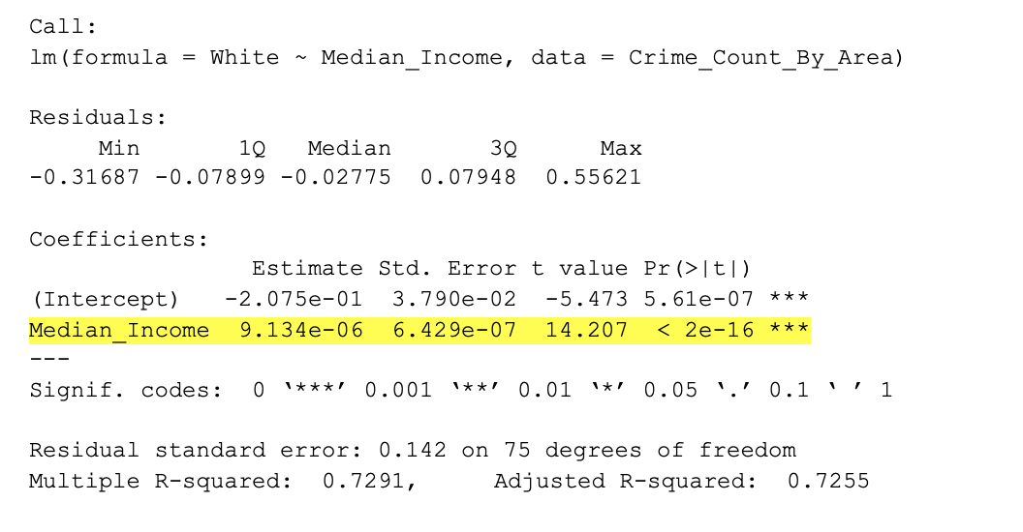
APPENDIX: AREA LEVEL ANALYSIS
Significant Relationship Between % of White Population & Median Income

Slide 35
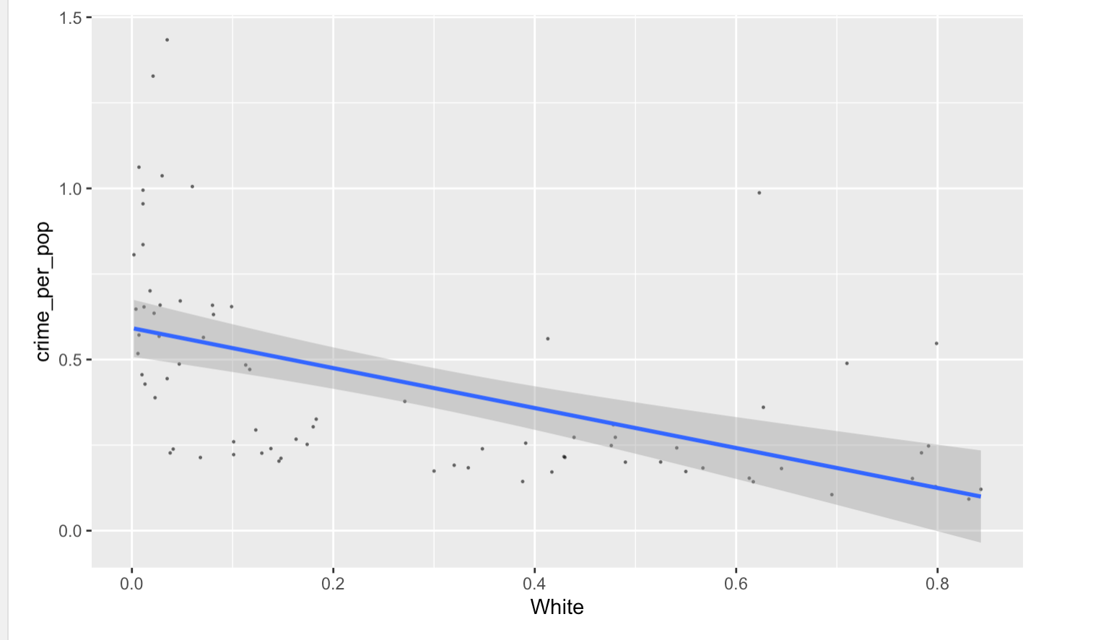
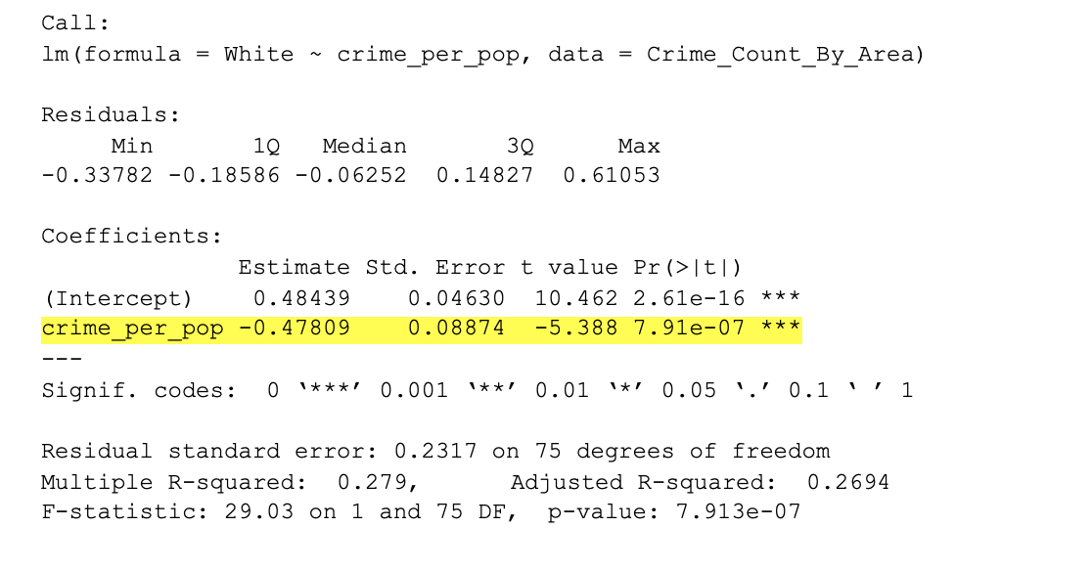
APPENDIX: AREA LEVEL ANALYSIS
Significant Relationship Between % of White Population & Crime Rate

Slide 36
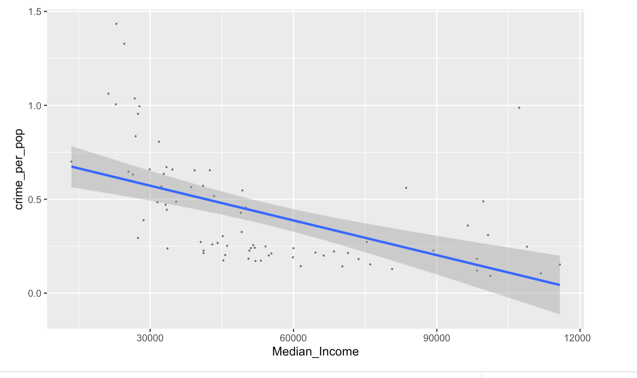
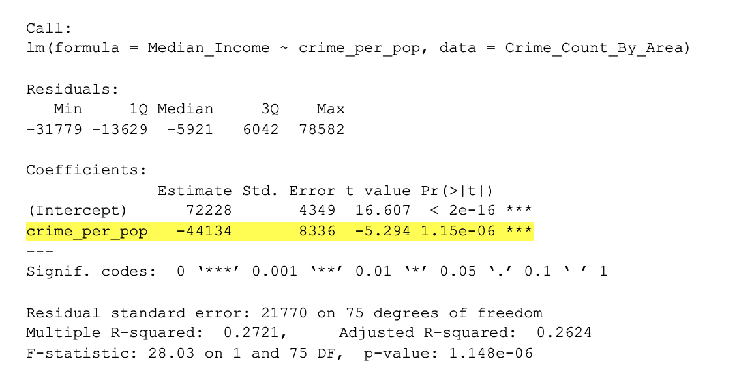
APPENDIX: AREA LEVEL ANALYSIS
Significant Relationship Between Median Income & Crime Rate

